Slide 1

Customer Shopping Behavior Analysis
Uncovering insights from transactional data to guide strategic business decisions.

Slide 2
PROJECT OVERVIEW
Data-Driven Strategy
Analyze 3,900 Purchases
Uncover Key Insights
Guide Decisions
Transactional data across various product categories.
Spending patterns, customer segments, and product preferences.
Inform strategic choices on marketing and operations.

Slide 3


DATASET SUMMARY
Key Features & Data Health
Dataset Size: 3,900 Rows / 18 Columns
Customer Demographics (Age, Gender, Location, Subscription)
Purchase Details (Item, Category, Amount, Season, Size, Color)
Shopping Behavior (Discount, Promo, Previous Purchases, Frequency, Rating, Shipping)
Missing Data: 37 values in Review Rating column.

Slide 4

EXPLORATORY DATA ANALYSIS (PYTHON)
Data Preparation & Feature Engineering
Data Loading & Exploration
Handling Missing Data
Imported dataset (pandas); checked structure and summary statistics.
Imputed missing Review Ratings using the median rating per product category.
Standardization & Consistency
Feature Engineering
Renamed columns to snake_case; dropped redundant 'promo_code_used' column.
Created age_group and purchase_frequency_days columns.

Slide 5
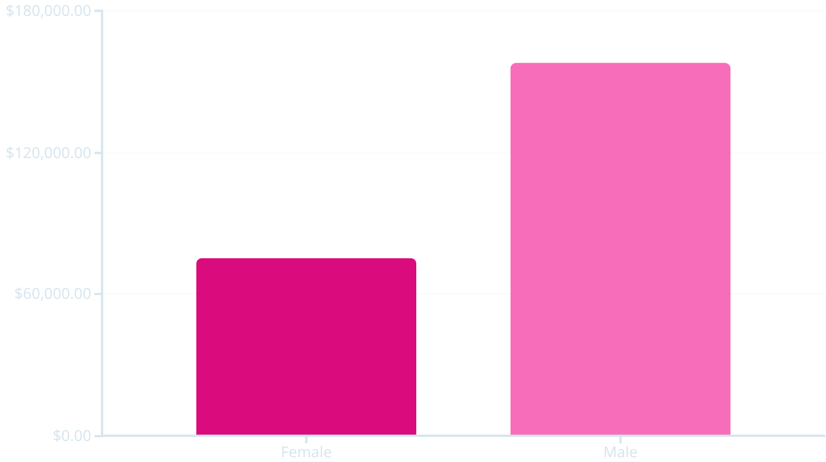

SQL ANALYSIS: REVENUE & SPENDING
Gender and Shipping Type Comparison
Revenue by Gender
Shipping Type vs. Average Spend
Male customers generated significantly more revenue.
Express shipping users have a slightly higher average purchase amount.
Shipping Type
Avg. Spend (USD)
Standard
58.46
Express
60.48

Slide 6

SQL ANALYSIS: PRODUCT & DISCOUNT
Top Products and Discount Dependency
Top 5 Rated Products
Discount-Dependent Products
High-Spending Discount Users
Gloves (3.86), Sandals (3.84), Boots (3.82), Hat (3.80), Skirt (3.78).
Hat (50.00%), Sneakers (49.66%), Coat (49.07%) have the highest discount rates.
Identified 839 customers who used discounts but still spent above the average purchase amount.

Slide 7

SQL ANALYSIS: CUSTOMER SEGMENTATION
Loyalty and Subscription Behavior
Customer Segments
Subscribers vs. Non-Subscribers
Classification based on purchase history:
Non-subscribers account for higher total revenue, but repeat buyers are more likely to subscribe.
Loyal
Non-Subscribers: 2,847 customers / $170,436 Revenue
Subscribers: 1,053 customers / $62,645 Revenue
3,116 Customers
Repeat Buyers (>5 purchases): 958 are Subscribers (Yes)
Returning
701 Customers
New
83 Customers

Slide 8
SQL ANALYSIS: PRODUCT CATEGORIES
Top 3 Products Per Category
Rank
Category
Item Purchased
Total Orders
1
Accessories
Jewelry
171
1
Clothing
Blouse
171
1
Footwear
Sandals
160
1
Outerwear
Jacket
163

Slide 9
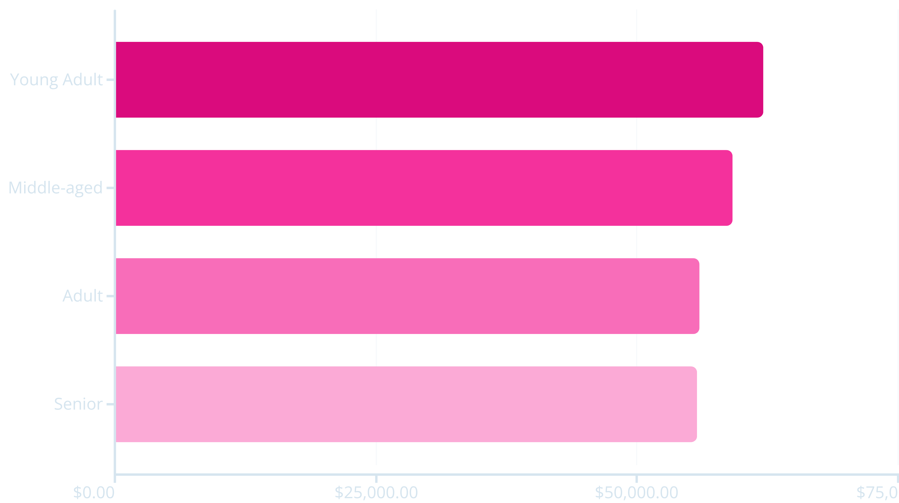
SQL ANALYSIS: AGE GROUPS
Revenue Contribution by Age
Young Adults contribute the highest total revenue, followed closely by Middle-aged customers.

Slide 10





BUSINESS RECOMMENDATIONS
Actionable Insights
Customer Loyalty
Boost Subscriptions
Reward repeat buyers to grow the "Loyal" segment.
Promote exclusive benefits to increase subscriber base.
Review Discount Policy
Balance sales boosts with margin control.
Targeted Marketing
Focus efforts on high-revenue age groups and express-shipping users.
Product Positioning
Highlight top-rated and best-selling items in campaigns.

